Slide 1
Weather Prediction on Mars as a Multivariate Time Series Forecasting Problem
Sagar Uprety^{1,2}, Amel Bennaceur¹, Carlos Gavidia-Calderon^{1,3}, James A. Holmes¹, Manish R. Patel¹ & Kylash Rajendran¹
¹The Open University, UK
²University College London, UK
³The Alan Turing Institute, UK
Notes:
Shorten the filiations

Slide 2
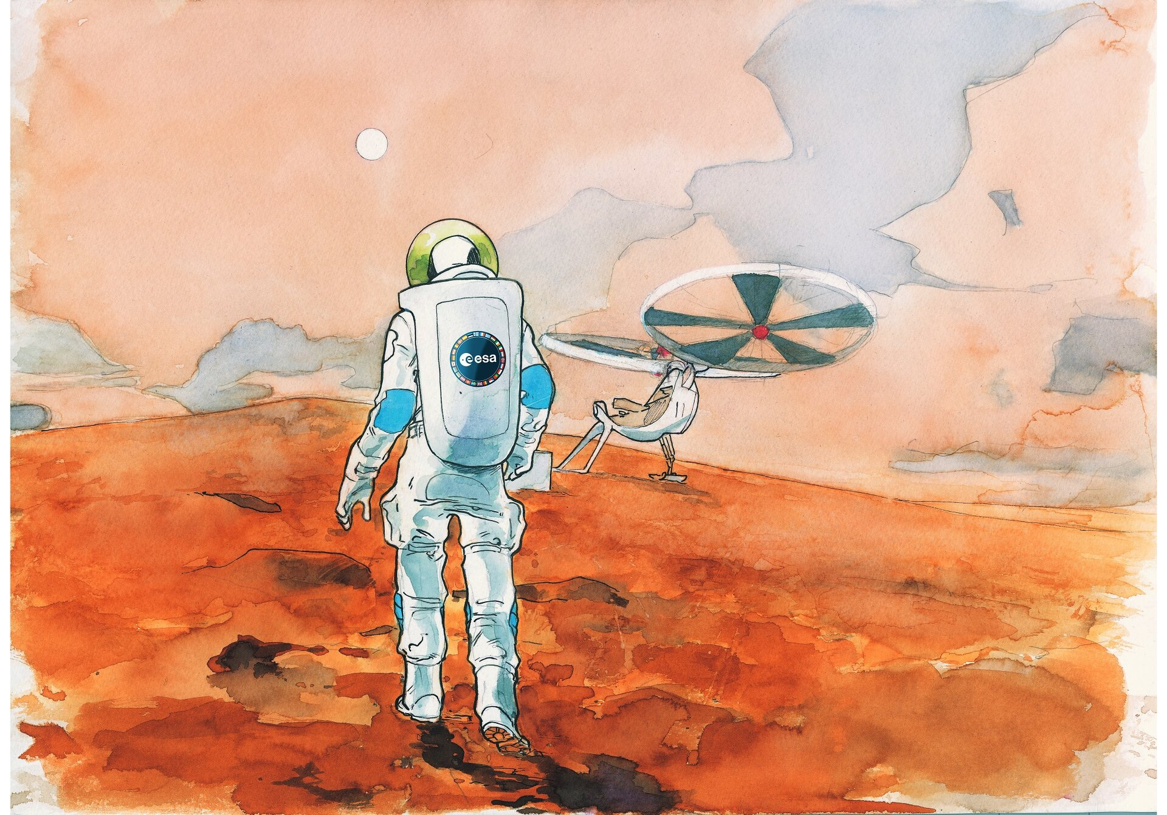
Motivation
Accurate weather prediction on Mars is imperative for the safety of future human explorers
Conventional physics-based numerical weather prediction face challenges due to sparse observational data and intricacies of the martian atmosphere
We propose to use Machine Learning (ML) to forecast martian weather using the OpenMARS reanalysis dataset

Slide 3
Research questions
Can an ML model provide a rapid forecast of the expected local weather on a par with complex physics-based numerical weather prediction models?
Can an ML model predict an impending global dust storm?
Do some particular ML models outperform others at the above tasks?

Slide 4
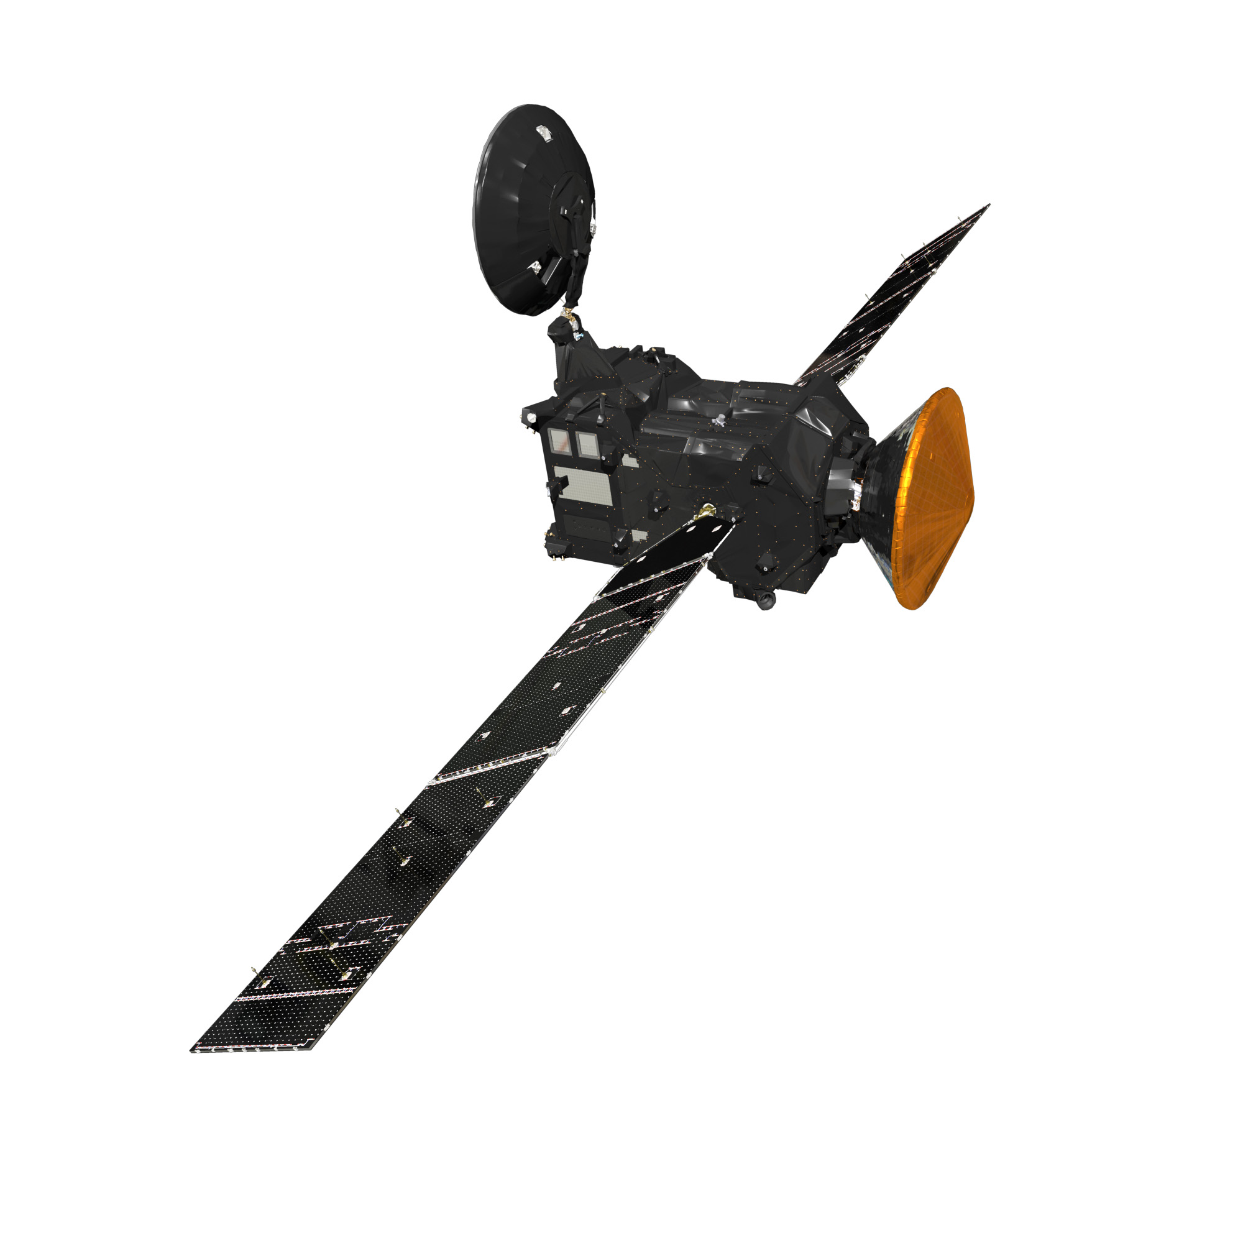
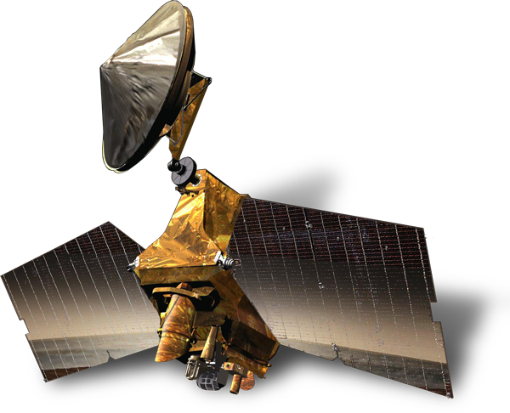
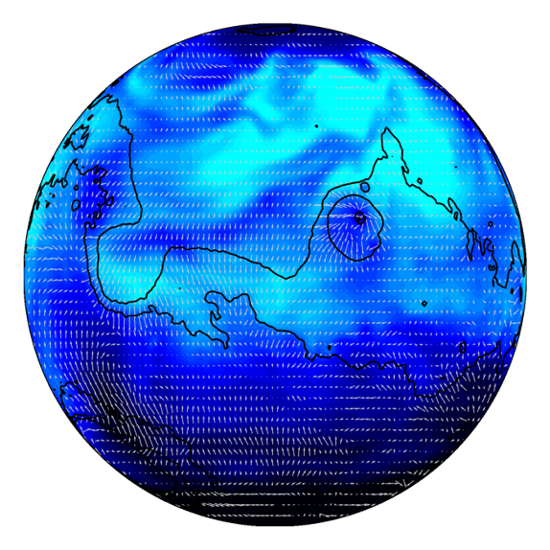
What is OpenMARS?
OpenMARSglobal reanalysis
dataset
Open access to Mars Assimilated Remote Soundings (OpenMARS) dataset.
Reanalysis product combining past spacecraft observations with a Mars Global Circulation Model
Global 4-D surface/atmosphere reference database of surface and atmospheric properties from July 1998 to April 2019 (equivalent to around eleven Mars years).
Credit: ESA/ATG medialab
Credit: mars.nasa.gov/mro
Observations
Trace Gas Orbiter
Mars Climate Sounder
Global Circulation Model

Slide 5
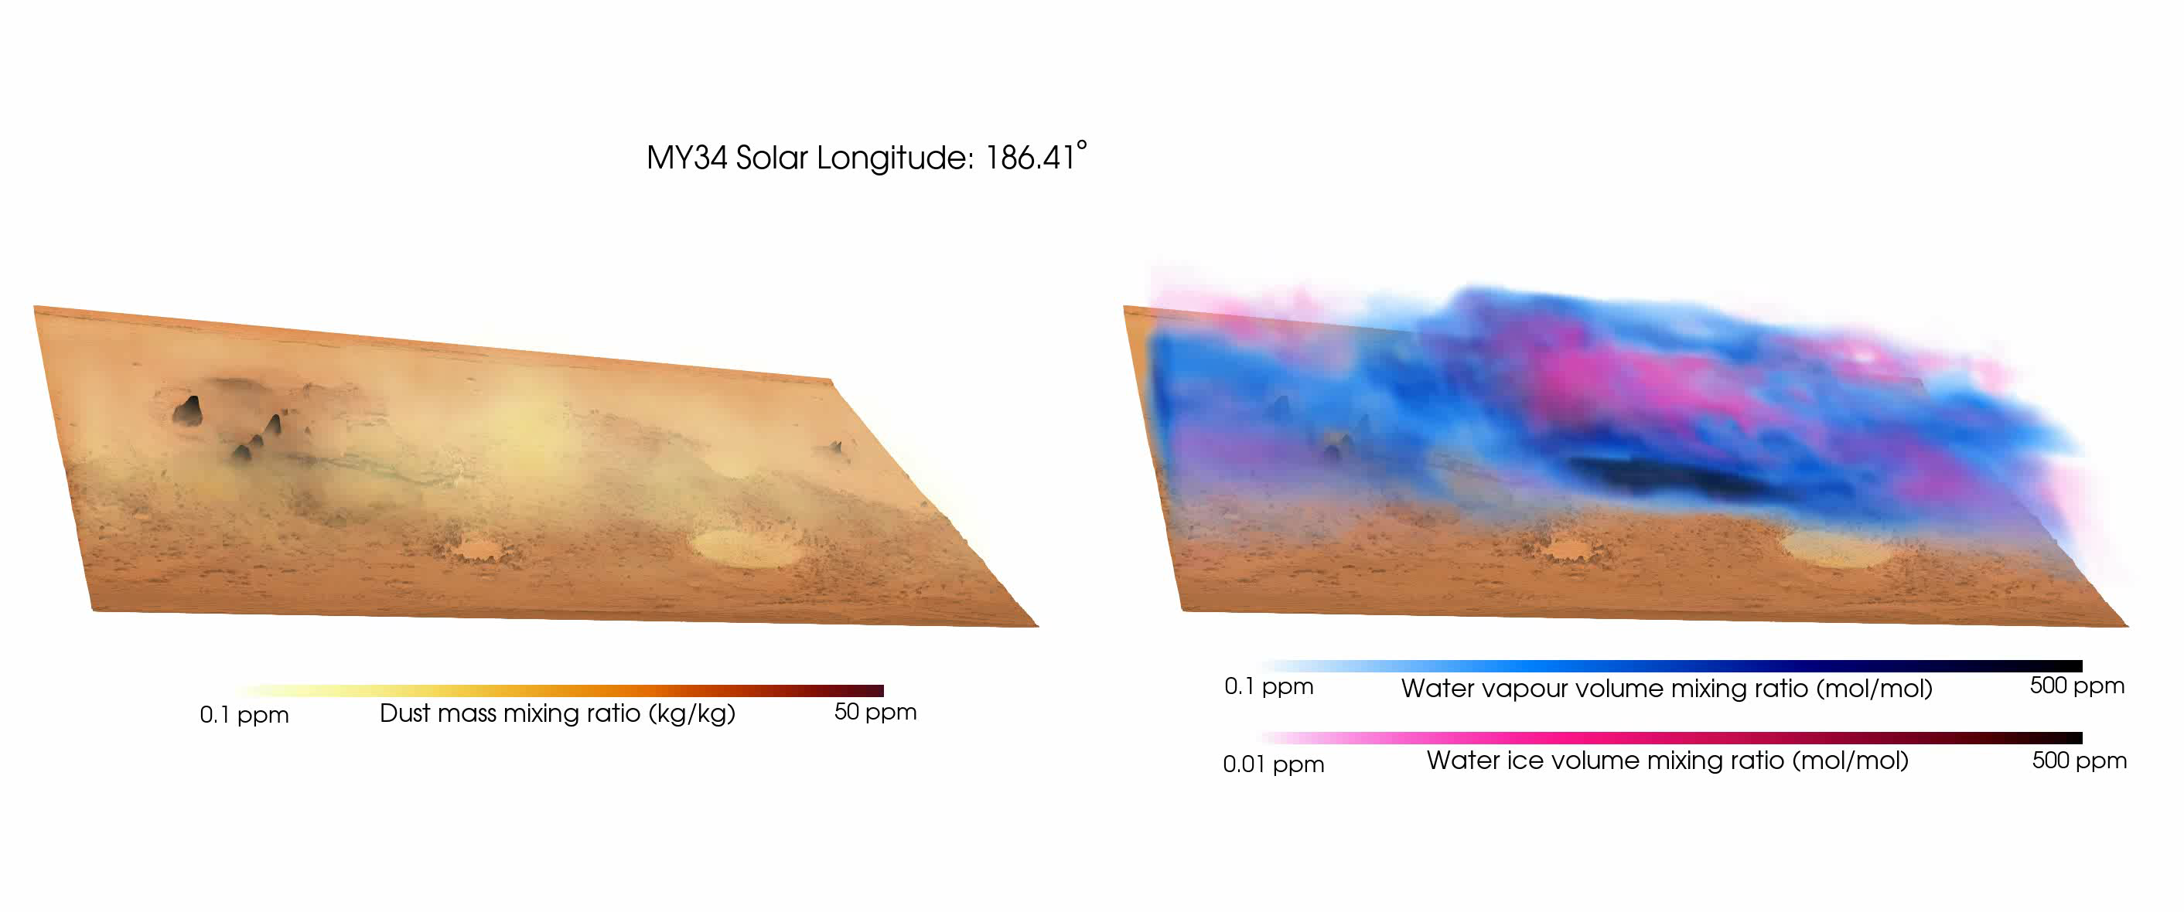
Dust/water during a Mars Global Dust Storm

Slide 6
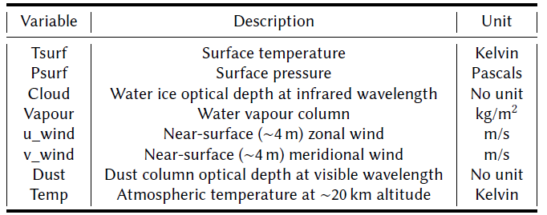
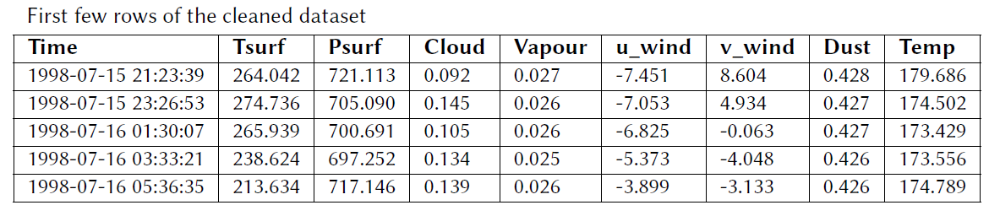
What data are we using from OpenMARS?
Focus on prediction of:
surface pressure
surface temperature
near-surface zonal wind speed
dust column

Slide 7
What coverage does OpenMARS contain?
Temporal resolution of the dataset is every two hours and in total there are 88,560 data points for each variable
Choose one atmospheric column from the complete OpenMARS spatial grid (5º lat-lon) corresponding to InSight landing site location for local forecasting
The dataset covers the timespan from the start of Mars Year 24 to just after the end of Mars Year 34, equivalently from 15th July 1998 to 23rd April 2019.
Split ratio of 70, 20 ,10 for training, validation and testing of ML models

Slide 8

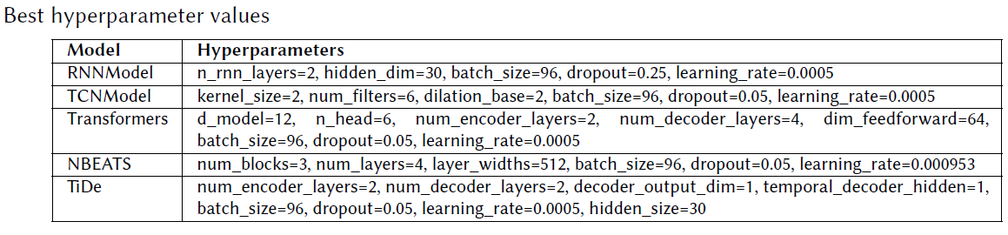
What ML models are we using?
Darts python library for training the time series forecasting ML models
Input_chunk_length = a week of Mars data
Output_chunk_length = one day of Mars data

Slide 9
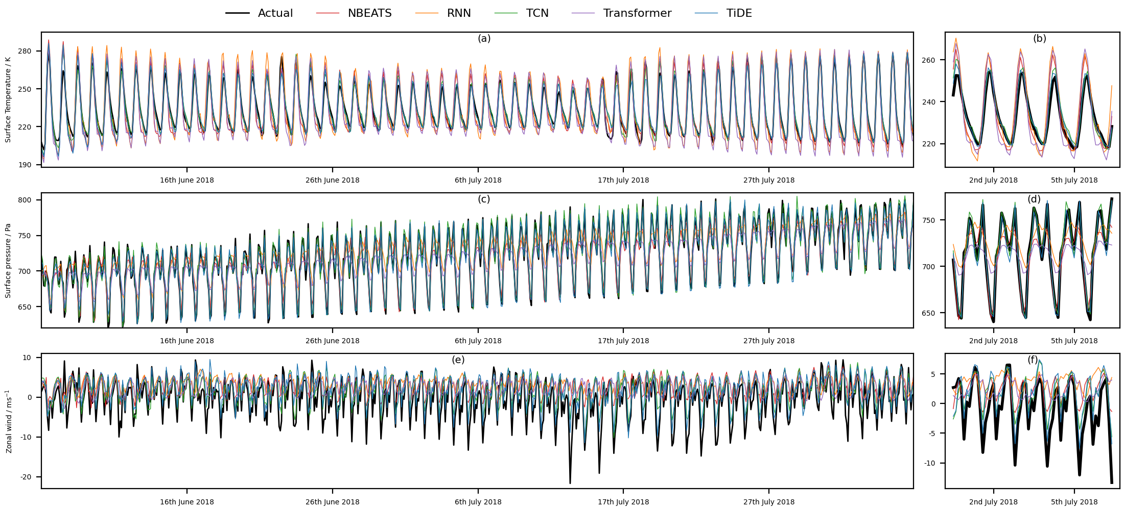
ML forecasting results

Slide 10
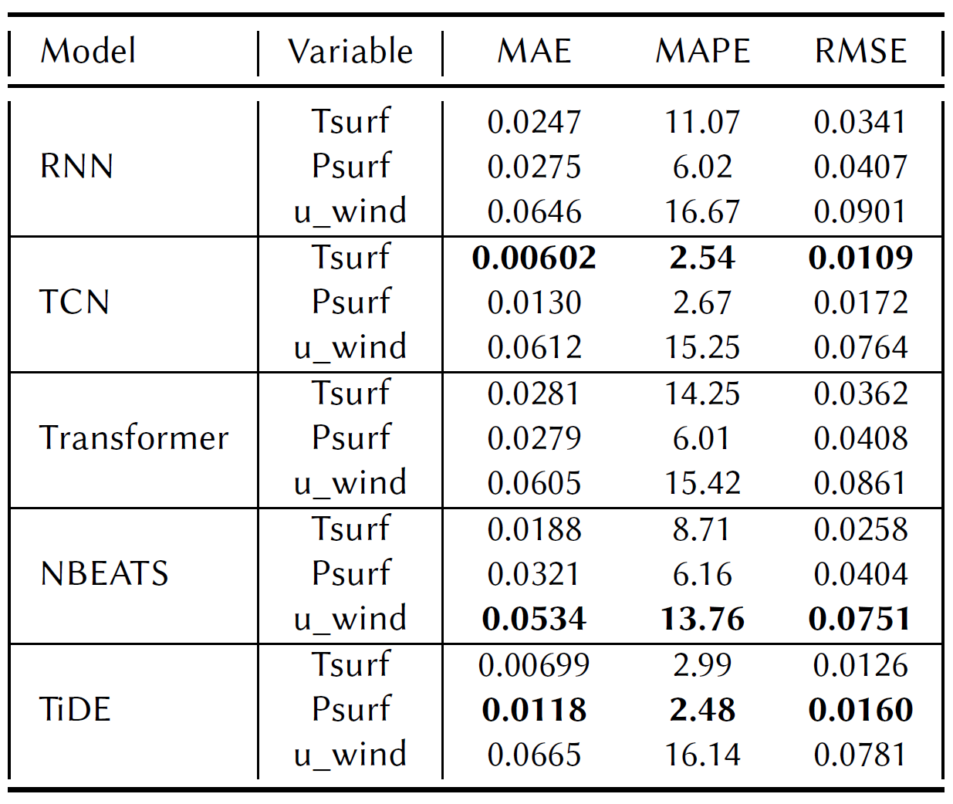
ML forecasting metrics
Three different ML models perform best for the three different variables predicted
Surface temperature: TCN
Surface pressure: TiDE
Zonal wind: NBEATS
Overall TCN model is perhaps the best model at predicting across all three variables and showed potentially interesting results for dust column optical depth too….

Slide 11
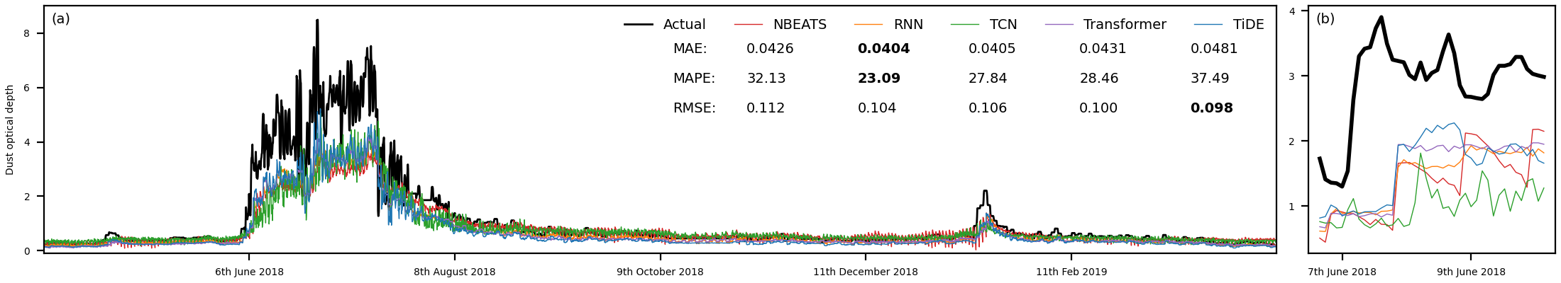
Case study: ML forecasting of a dust storm
Not a huge amount of intrinsic variability between the different ML model forecasts
TCN model shows abrupt increase just as the global dust storm is initiating in reality (within the noise?)

Slide 12
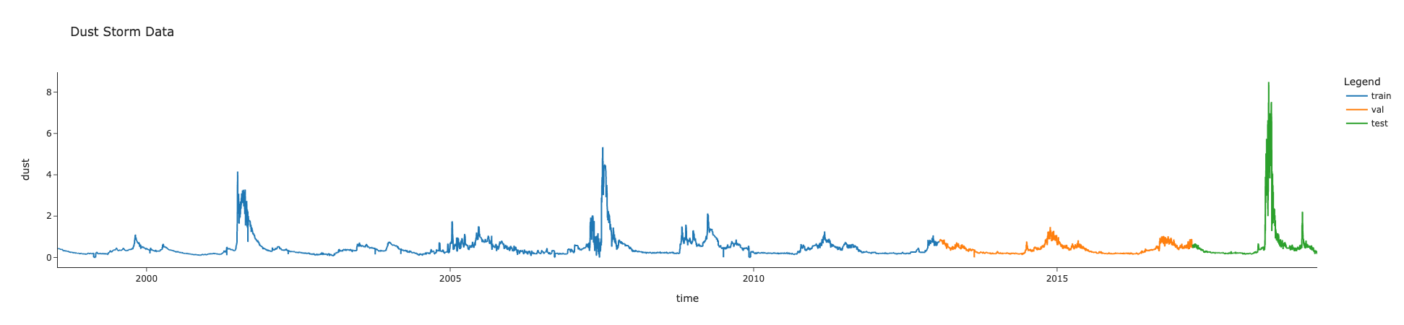
Why is it difficult to forecast a global dust storm?
There were only two instances of global dust storms in training dataset over the nine Mars years included
The three global dust storms in the entire dataset occur at different times of the year

Slide 13
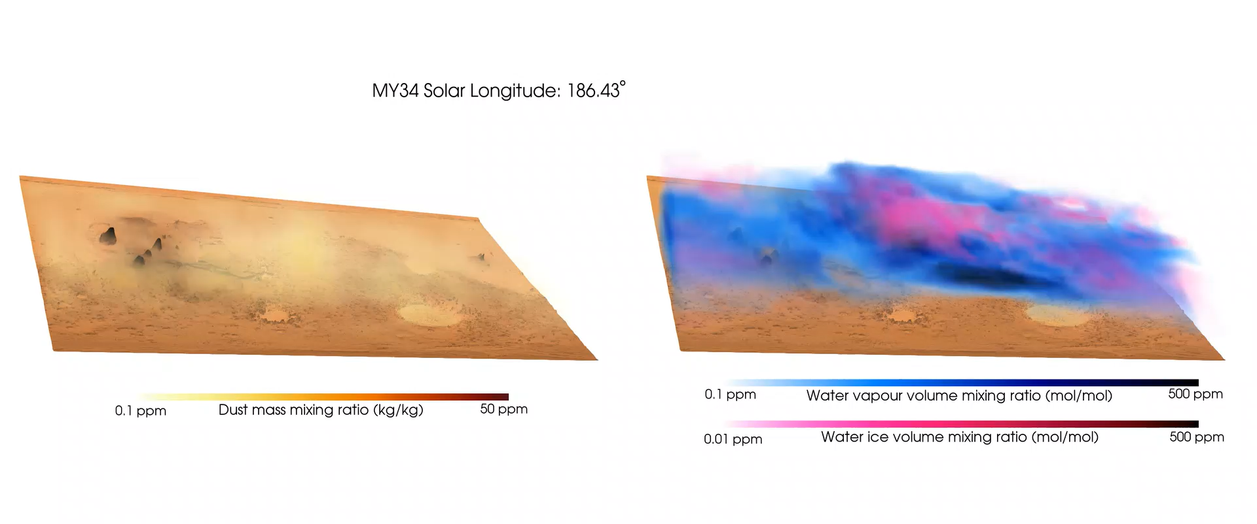

Summary
TCN and TiDE ML models most efficient in reproducing realistic tidal structures in surface pressure
Dust storms are difficult to predict on Mars!
Future work:
Testing ML models on actual data alone (e.g. InSight lander)
Extend the training data through including more recent reanalysis data
Open question: are there other known methods to tackle dust forecasting?
Replication package and benchmarking results are publicly accessible here: https://github.com/amelBennaceur/OpenMarsML
OpenMARS database version 5
→

